Slide 1


Why do things float?
Notes:
Misconception
Light things float and heavy things sink
Corrected:
Floating depends on the density of the object and the density of the fluid it is placed in.
(air and water are both fluids)

Slide 2
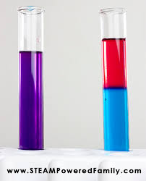
ABC Education - Salt water density experiment
https://education.abc.net.au/home#!/media/106652/salt-water-density-experiment

Slide 3
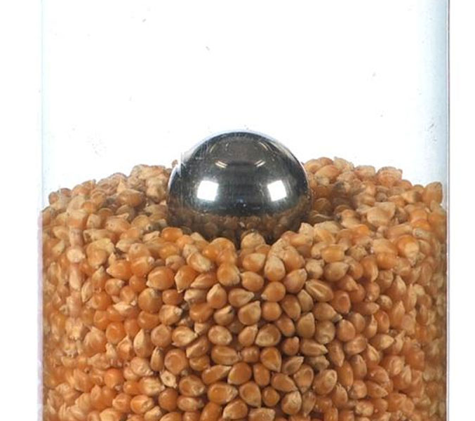
Objects that are less dense than the surrounding fluid float.
Objects that are more dense than the surrounding fluid sink.

Slide 4
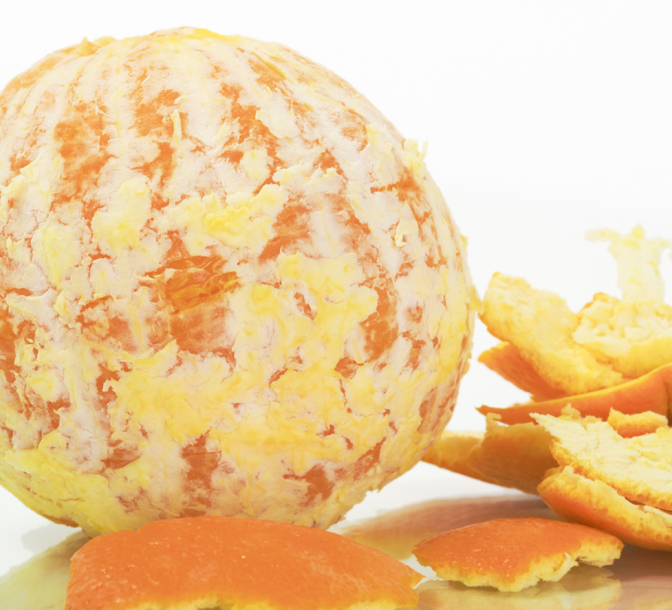
Oranges problem
Will it float or sink?
Predict whether an orange will float or sink.
Predict whether a peeled orange will float or sink.
Test your predictions.
Can you explain your observations?
Notes:
POE exercise

